Slide 1

Project given by

Slide 2
ACKNOWLEDGEMENT
The opportunity to participate in these internships has been an invaluable experience for my personal and professional development. I am extremely grateful to Dr. P L Madhava Rao sir for facilitating my placement with SMARTINTERZ and to Dr. P L Madhava Rao sir for providing me with guidance and mentorship throughout my time at Flying Machine Company.
My digital marketing internship at Flying Machine Company was an eye-opening experience that exposed me to the intricacies of marketing in the real world. Working closely with the team, I was able to contribute to various campaigns and initiatives, gaining hands-on experience in digital marketing strategies, analytics, and customer engagement.
I would also like to express my sincere appreciation to the college director, principal, and Head of the Department for providing me with the opportunity to undertake these internships as part of my academic curriculum. Your commitment to fostering practical learning experiences has greatly enriched my education.
would also like to express my sincere appreciation to my team members for their unwavering support during my internship. Their encouragement, and willingness to share their expertise have been instrumental in my growth as a digital marketing professional.
Once again, thank you for the support and guidance that have made these internships a reality. I look forward to your feedback and am open to any further recommendations or suggestions for my future endeavors

Slide 3
TEAM MEMBERS
Team lead : P Krishna Priya
Team member : Sarimalla Peddasagar
Team member : Sasikiranreddyvippala
Team member : Siddarapu Adarsh
Team member : Undela Swapna
Team member : Chagini sasidharreddy

Slide 4
Brand study, Competitor Analysis & Buyer’s/Audience’s Personal
Flying Machine is an Indian denim and casual wear brand owned by Arvind Limited. It was launched in 1980 and has since become a prominent name in the Indian fashion industry.
*Market Positioning:* Flying Machine is positioned as a youthoriented brand that offers trendy and fashionable denim and casual wear. It's known for its edgy and contemporary designs, appealing to the younger demographic.

Slide 5
Analysis:
*Target Audience:* The brand primarily targets the urban youth and young adults who are fashion-conscious and value style and individuality. Its designs cater to those who want to make a statement with their clothing choice
Product Range:* Flying Machine offers a wide range of products including jeans, shirts, t-shirts, jackets, and accessories. Its focus on denim products has helped it carve a niche in the Indian fashion market.

Slide 6
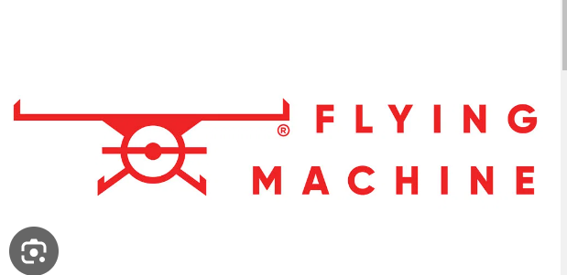
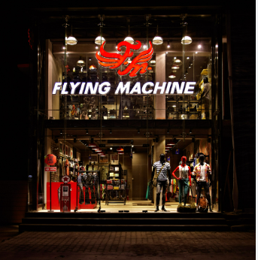
Social Media:*

Slide 7
History of Flying Machine:
Flying Machine is one of the indigenously grown brands started by garment division of Arvind mills.
The brand was incepted in 80’s
It is among few early brands which started the denim category in India though consumption was pretty low.

Slide 8
Flying Machine has increased its online visibility, strengthened its marketplace business and grown its sales quite significantly.
Following are the few impacts that Rubicon enabled for Flying Machine from Q1 17-18 to Q4 17-18.
23 times rise in GMV
22 times rise in orders across marketplaces
Fulfilment rate increased to 98.99%
Sell through increased by 25%

Slide 9
Flying Machine India Company Profile
Company Full Name: Arvind Limited
Type: Private
Industry: Fashion wear
Founded Year: 1980
Founder: NA
Headquarters: Naroda, Ahmedabad, Gujarat, India
Key People: Mr. Sanjay Lalbha (CEO & MD)
Parent Company: Lalbhai Group
Subsidiaries: NA

Slide 10
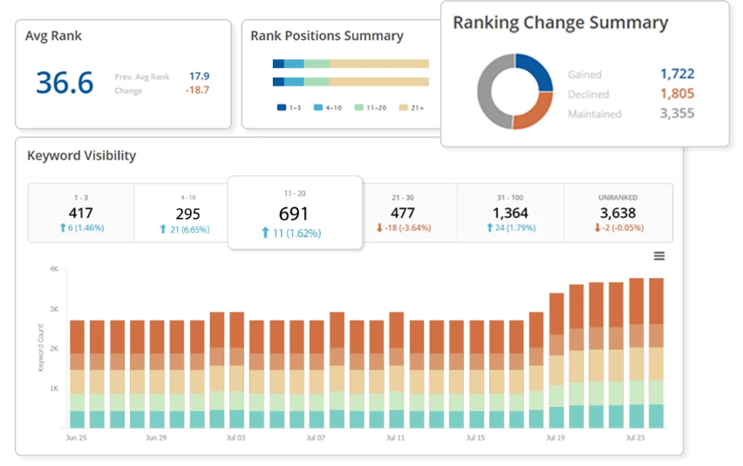
Rankings of keywords
Keyword rankings refer to the positions that specific keywords or key phrases hold in the search engine results pages (serps) when users search for those terms.
Well defined categories with Innovative jeans wear in FM, Entry price point heavy in FMX range & Urban play for digital natives in FM2001

Slide 11

Email Marketing
Flying Machine Head Office Email
ID: care@nnnow.com

Slide 12
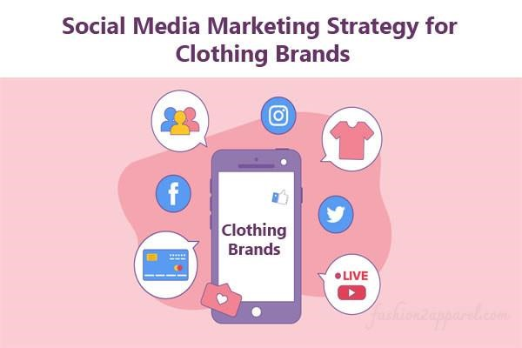
Social Media Marketing
Facebook is the most used social media platform in the world with 2.45 billion monthly active users.
Instagram has an active global audience of 500 million daily active users, collectively tapping the platform’s “Like” button 4.2 billion times every day.
69 percent of marketers plan to spend more money on Instagram influencers than any other market this year.

Slide 13
Link :
https://instagram.com/flyingmachine80?igshid=
MmU2YjMzNjRlOQ==

Slide 14
marketing
Content Marketing
Pay per click advertising
Video marketing
Instagram
Facebook

Slide 15
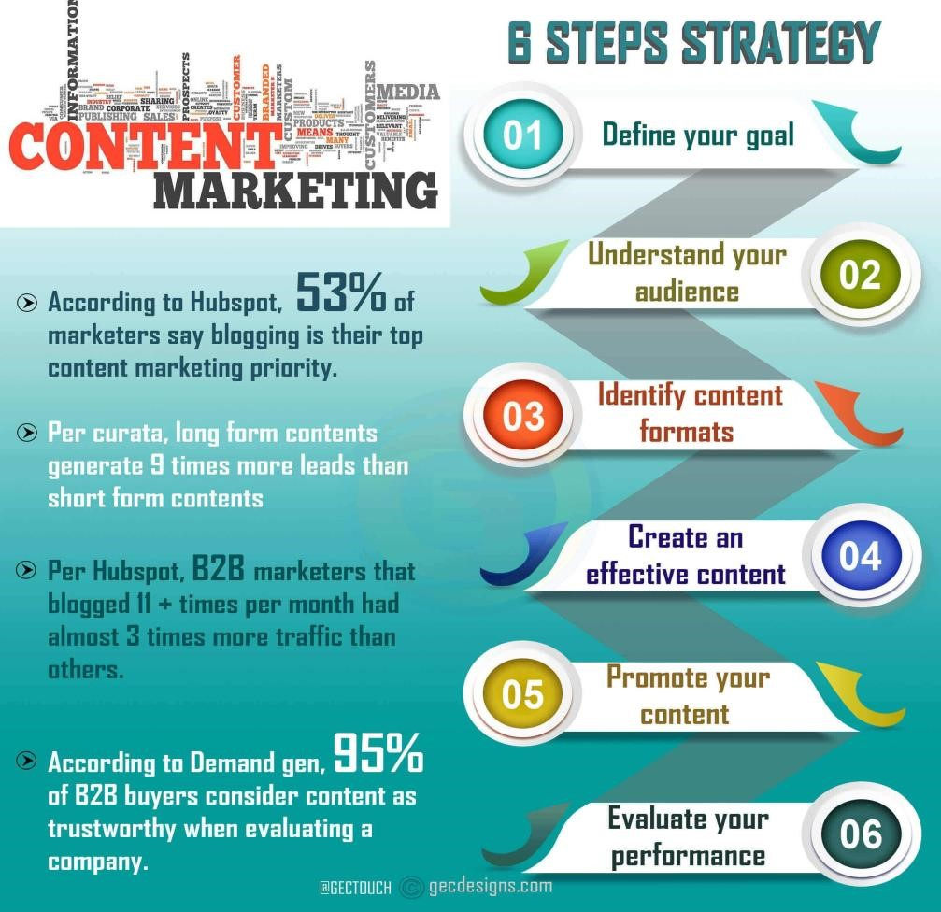
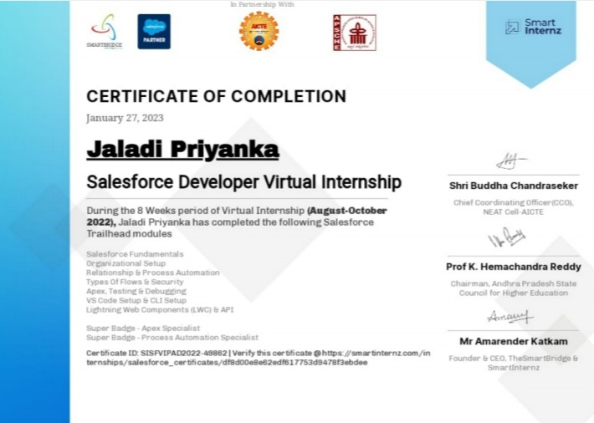
Content Marketing
Content marketing is an essential strategy that allows businesses to reach, engage and connect with clients through unique content

Slide 16
Thank you

